Slide 1
BUSINESS TEMPLATE
论文答辩开题报告模板
Just for today I will try to live through this day only and not tackle my whole life problem at once. Just for today I will try to live through this day only and not tackle my whole life problem at once.

Slide 2
C O N T E N T
选题的背景及意义
研究方法及过程
0 1
0 2
您的内容打在这里，或者通过复制您的文本后，在此框中选择粘贴，并选择只保留文字。
您的内容打在这里，或者通过复制您的文本后，在此框中选择粘贴，并选择只保留文字。
研究成果展示及其应用
论文总结
0 3
0 4
您的内容打在这里，或者通过复制您的文本后，在此框中选择粘贴，并选择只保留文字。
您的内容打在这里，或者通过复制您的文本后，在此框中选择粘贴，并选择只保留文字。

Slide 3
选题的背景及意义
0 1
Just for today I will try to live through this day only and not tackle my whole life problem at once. Just for today I will try to live through this day only and not tackle my whole life problem at once.

Slide 4
1
2
Solar Energy
Solar Energy
在这里添加你的文字，图片也可以。在这里可以添加文字内容。
在这里添加你的文字，图片也可以。在这里可以添加文字内容。
3
4
Solar Energy
Solar Energy
在这里添加你的文字，图片也可以。在这里可以添加文字内容。
在这里添加你的文字，图片也可以。在这里可以添加文字内容。

Slide 5
vs
50%
60%
点击添加标题
点击添加标题
您的内容打在这里，或者通过复制您的文本后，在此框中选择粘贴，并选择只保留文字,您的内容打在这里
您的内容打在这里，或者通过复制您的文本后，在此框中选择粘贴，并选择只保留文字,您的内容打在这里

Slide 6
点击添加标题
点击添加标题
点击添加标题
您的内容打在这里，或者通过复制您的文本后，在此框中选择粘贴，并选择只保留文字。
您的内容打在这里，或者通过复制您的文本后，在此框中选择粘贴，并选择只保留文字。
您的内容打在这里，或者通过复制您的文本后，在此框中选择粘贴，并选择只保留文字。

Slide 7
请输入你的题目
请输入你的题目
请输入你的题目
请输入你的题目
Just for today I will try to live through this day only and not tackle my whole life problem at once. Just for today I will try to live through this day only and not tackle my whole life problem at once.
Just for today I will try to live through this day only and not tackle my whole life problem at once. Just for today I will try to live through this day only and not tackle my whole life problem at once.
Just for today I will try to live through this day only and not tackle my whole life problem at once. Just for today I will try to live through this day only and not tackle my whole life problem at once.
Just for today I will try to live through this day only and not tackle my whole life problem at once. Just for today I will try to live through this day only and not tackle my whole life problem at once.

Slide 8
研究方法及过程
0 2
Just for today I will try to live through this day only and not tackle my whole life problem at once. Just for today I will try to live through this day only and not tackle my whole life problem at once.

Slide 9
SUBTITLE
CLICK HERE TO ADD YOUR CONTENTS
SUBTITLE
CLICK HERE TO ADD YOUR CONTENTS
Just for today I will try to live through this day only and not tackle my whole life problem at once. I can do for twelve hours that Just for today I will try to live through this day

Slide 10
04 YOUR TITLE
03 YOUR TITLE
Click here to enter your text messages click here to enter your text messages click here to enter your text
02 YOUR TITLE
01 YOUR TITLE
Click here to enter your text messages click here to enter your text messages click here to enter your text
Click here to enter your text messages click here to enter your text messages click here to enter your text
Click here to enter your text messages click here to enter your text messages click here to enter your text

Slide 11
three ways. I will do somebody a good turnJust for today I will try to live through this day only and not tackle my
three ways. I will do somebody a good turnJust for today I will try to live through this day only and not tackle my
three ways. I will do somebody a good turnJust for today I will try to live through this day only and not tackle my
three ways. I will do somebody a good turnJust for today I will try to live through this day only and not tackle my
three ways. I will do somebody a good turnJust for today I will try to live through this day only and not tackle my
three ways. I will do somebody a good turnJust for today I will try to live through this day only and not tackle my

Slide 12
Just for today I will try to live through this day only and not tackle my whole
ADD TITTLE HERE
TITTLE HERE
THIS IS A REMO TEMPLATE ,THANK YOU WATCHING THIS ONE
TITTLE HERE
Just for today I will try to live through this day only and not tackle my whole

Slide 13
研究成果展示及其应用
0 3
Just for today I will try to live through this day only and not tackle my whole life problem at once. Just for today I will try to live through this day only and not tackle my whole life problem at once.

Slide 14
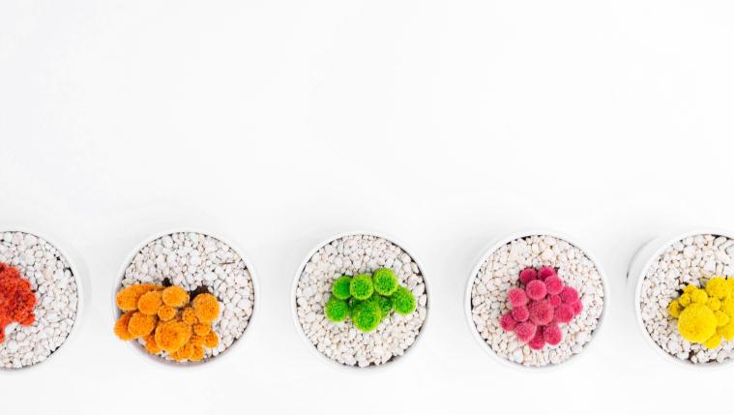
01
Just for today I will try to live through this day only and not tackle my whole life problem at once. I can do for twelve hours that
02
Just for today I will try to live through this day only and not tackle my whole life problem at once. I can do for twelve hours that
03
Just for today I will try to live through this day only and not tackle my whole life problem at once. I can do for twelve hours that
04
Just for today I will try to live through this day only and not tackle my whole life problem at once. I can do for twelve hours that

Slide 15
ADD YOUR TITLE
ADD YOUR TITLE
ADD YOUR TITLE
ADD YOUR TITLE
Click here to enter your text messages click here to enter your text messages
Click here to enter your text messages click here to enter your text messages
Click here to enter your text messages click here to enter your text messages
Click here to enter your text messages click here to enter your text messages

Slide 16
Just for today I will try to live through this day only and not tackle my whole life at once. I can do Just for today I will try to live through
Just for today I will try to live through this day only and not tackle my whole life at once. I can do Just for today I will try to live through
Just for today I will try to live through this day only and not tackle my whole life at once. I can do Just for today I will try to live through
Just for today I will try to live through this day only and not tackle my whole life at once. I can do Just for today I will try to live through
Just for today I will exercise my soul in three ways. I will do somebody a good turnJust for today I will exercise my soul

Slide 17
ADD YOUR TITTLE HERE
I CAN DO SOMETHING FOR TWELVE HOURS THAT
Just for today I will try to live through this day only and not tackle my whole life problem at once. I can do for twelve hours that Just for today I will try to live through this day. Just for today I will try to live through this day only and not tackle my whole life problem at once.

Slide 18
论文总结
0 4
Just for today I will try to live through this day only and not tackle my whole life problem at once. Just for today I will try to live through this day only and not tackle my whole life problem at once.

Slide 19
THIS IS A REMO TEMPLATE ,THANK YOU WATCHING THIS ONE.THIS IS A REMO TEMPLATE ,THANK YOU WATCHING THIS ONE.
Just for today I will try to live through this day only and not tackle my whole life problem at once. I can do for twelve hours that Just for today I will try to live through this day. Just for today I will try to live through this day only and not tackle my whole life problem at once.
ART TEMPLATE

Slide 20
STEP 01
STEP 02
Just for today I will try to live through this day only and not tackle my whole
Just for today I will try to live through this day only and not tackle my whole
STEP 03
STEP 04
Just for today I will try to live through this day only and not tackle my whole
Just for today I will try to live through this day only and not tackle my whole

Slide 21
在这里添加你的文字，图片也可以。在这里可以添加文字内容。
在这里添加你的文字，图片也可以。在这里可以添加文字内容。
在这里添加你的文字，图片也可以。在这里可以添加文字内容。
Start
Finish
在这里添加你的文字，图片也可以。在这里可以添加文字内容。
在这里添加你的文字，图片也可以。在这里可以添加文字内容。
在这里添加你的文字，图片也可以。在这里可以添加文字内容。

Slide 22
BUSINESS TEMPLATE
感 谢 观 看
Just for today I will try to live through this day only and not tackle my whole life problem at once. Just for today I will try to live through this day only and not tackle my whole life problem at once.

